Slide 1


Delicate Information Exchange among representative and authority (Network Security) Batch A23

Slide 2

Team Details
Gayathri S – 2018PECCS132
Hyshwarrya J D – 2018PECCS139
Keerthana P N – 2018PECCS148
Project Guide : Mrs. D. Jenifer(Asst. prof)

Slide 3
ABSTRACT
The main aim is to provide a safer environment for sensitive data transactions between the delegate and authority to prevent data leakage if any.
This application provides a distributed application service and uses the blockchain technology to support it.
The SaaS layer module offers a cloud-platform service that allows each party to easily engage in business communications via web portals.
The proposed smart system is used by each party getting involved in the transfer of sensitive data.

Slide 4
ADVANCEMENTS
Existing System
Cons
Most of the existing homomorphic secret sharing and secure multi-party computing technologies have the problems of massive communication rounds and too much traffic load.
Methodology: Different Hash Function Model, DSA Encryption.
It takes long time to process various hash function methods.
DSA algorithm requires lot of time to authenticate.
Data is not encrypted in DSA.

Slide 5
ADVANCEMENTS
Proposed System
Pros
The proposed smart system is used by admin or authority getting involved in the transfer of sensitive data. The final sensitive data is only accessed by the final data administrator or authority person.
Methodology: SHA algorithm, AES Algorithm.
It gives standard and valid solution to process the data with hash function.
Data is encrypted using AES and stored in the cloud.
Block chain is used to connect the hash values.
QR Code generation.

Slide 6
HARDWARE REQUIREMENTS
PROCESSOR : DUAL CORE 2 DUOS
RAM : 2 GB RAM
HARD DISK : 250 GB

Slide 7
SOFTWARE REQUIREMENTS
FRONT END : HTML, CSS, Js, JQuery
BACK END : JAVA
DATABASE : MYSQL
IDE (S/W Used) : ECLIPSE
OS : WINDOWS 7

Slide 8
TECHNOLOGIES USED
AES Encryption
SHA Algorithm
Block Chain technology (Hashing technique)
AWS Cloud Platform – RDS

Slide 9
TIMELINE CHART
WEEK2
WEEK 6
2021
WEEK 1
WEEK 3
WEEK 4
WEEK 5
WEEK 7
2021
56 days
Today
100%
UI Design
41 days
50%
50 days
Database Creation
38%
210 days
40%
Encryption
26 days
35 days
Backend Design
Permission controls
Execution

Slide 10
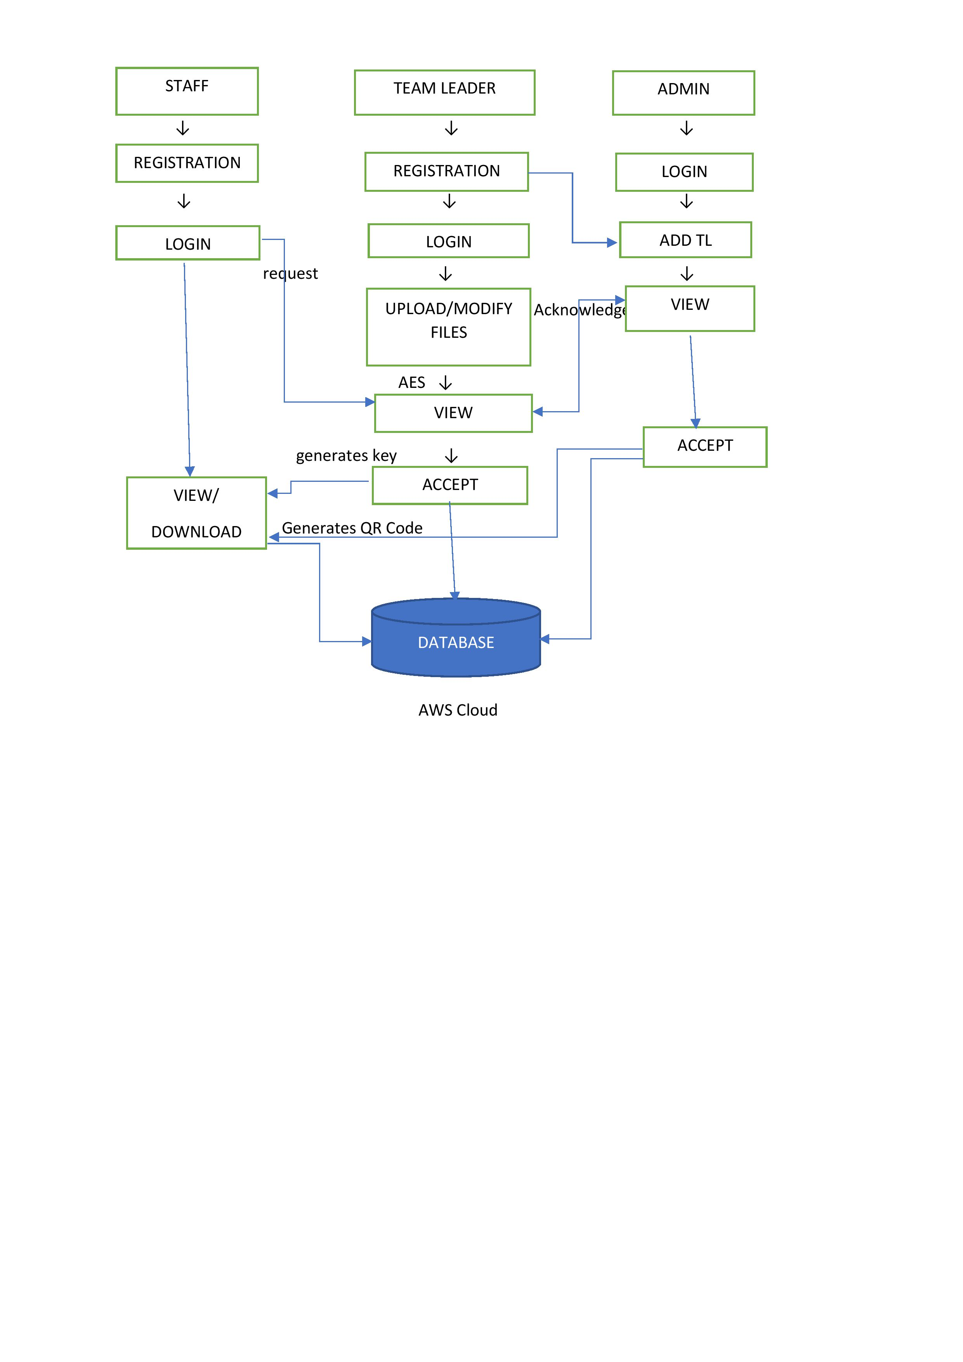
SYSTEM ARCHITECTURE

Slide 11

LITERATURE SURVEY

Slide 12

PAPER 1
Authors:
X. Su, I. Ullah, M. Wang and C. Choi
Title:
"Blockchain-Based System and Methods for Sensitive Data Transactions”
Journal Name:
IEEE Consumer Electronics Magazine
Year : 2021
The smart network comprises a “blockchain module, and a Software-as-a-Service (SaaS) layer module”.
The underlying blockchain module provides technical support, such as virtual machines, consensus algorithms, transaction verification mechanisms, and accounting mechanisms, DSA Algorithm.
The proposed smart system is “used by each party get involved in the production of sensitive data”.

Slide 13
PAPER 2
Authors:
Sanjeev Kumar Dwivedi, Ruhul Amin, Satyanarayana Vollala
Title:
“Blockchain based secured information sharing protocol in supply chain management system with key distribution mechanism “
Journal Name:
Journal of Information Security and Applications.
Year : 2020
This paper describes how the blockchain mechanism combines with the traditional pharmaceutical supply chain system and to achieve a better SCM system, we present a “blockchain-based scheme” for information sharing securely in the pharmaceutical supply chain system with smart contracts and consensus mechanism.
The proposed scheme also provides a mechanism to “distribute required cryptographic keys” to all the participants securely using the smart contract technique.

Slide 14
PAPER 3
Authors:
G. A. Thushara and S. M. S. Bhanu
Title:
"A Survey on Secured Data Sharing using Ciphertext Policy Attribute Based Encryption in Cloud”
Journal Name:
8th International Conference on Smart Computing and Communications (ICSCC), 2021, pp. 170-177
Year : 2021
“Cloud based information sharing” is a technique that allows researchers to communicate and collaborate, that leads to major new developments in the field.
It also enables users to “access data” over the cloud easily and conveniently. Privacy, authenticity and confidentiality are the three main challenges while sharing data in cloud.
“Attribute Based Encryption(ABE), Role Based Encryption, Hierarchical Based Encryption, and Identity Based Encryption”, are types of encryption.

Slide 15
PAPER 4
Authors:
P. Zhang and M. Zhou
Title:
"Security and Trust in Blockchains: Architecture, Key Technologies, and Open Issues,“
Journal Name:
IEEE Transactions on Computational Social Systems, vol. 7, no. 3, pp. 790-801
Year : 2020
The “decentralization feature” in blockchain reduces the reliance on the trusted authorities and third parties.
The work discusses the “basic architecture of blockchains as well as its potential security” and trust issues at data, network, consensus, smart contract, and application layers.
Then, the related “literature work is analyzed in terms of the issues at these layers”.

Slide 16
PAPER 5
Authors:
F. Sadique, K. Bakhshaliyev, J. Springer and S. Sengupta
Title:
"A System Architecture of Cybersecurity Information Exchange with Privacy (CYBEX-P)”
Journal Name:
IEEE 9th Annual Computing and Communication Workshop and Conference (CCWC)
Year : 2019
In this paper, we argue that privacy preservation of shared threat data will motivate entities to share threat data.
Accordingly, we propose a framework called CYBersecurity information EXchange with Privacy (CYBEX-P) to achieve this. CYBEX-P is a structured information sharing platform with integrating privacy-preserving mechanisms.
We propose a complete system architecture for CYBEX-P that guarantees maximum security and privacy of data. CYBEX-P outlines the details of a cybersecurity information sharing platform.

Slide 17
PAPER 6
Authors:
A. Hamza and B. Kumar
Title:
"A Review Paper on DES, AES, RSA Encryption Standards,"
Journal Name:
9th International Conference System Modeling and Advancement in Research Trends (SMART), 2020, pp. 333-338
Year : 2020
The objective of this review paper is to give light review for readers and students of the three common used algorithm two in symmetric cryptography DES, AES and one in asymmetric cryptography RSA.
The paper will sequentially list and review the said algorithms and clarify the relational between them.
Such as the relation between the symmetric and asymmetric algorithm the one with secret key and the ones with key pairs.

Slide 18
PAPER 7
Authors:
P. K. Wan, L. Huang and H. Holtskog
Title:
"Blockchain-Enabled Information Sharing Within a Supply Chain: A Systematic Literature Review,"
Journal Name:
IEEE Access, vol. 8, pp. 49645-49656, 2020
Year : 2020
The goal of this paper is to identify and understand the impact of blockchain technology for information sharing within a supply chain.
The decentralized nature of blockchain technology offers a high level of transparency and has gained the attention from various sectors to deploy this technology.

Slide 19
PAPER 8
Authors:
Santosh Kumar Smmarwar, Govind P. Gupta and Sanjay Kumar
Title:
A Study on Data Sharing Using Blockchain System and Its Challenges and Applications
Journal Name:
IGI GLOBAL Publisher of Timely Knowledge
Year : 2022
Process of data sharing has many addressed and unaddressed challenges such as information encryption and decryption, data authentication, storage security, latency time, transfer speed of data, detecting malicious nodes, prevent the computer system from attacks, trust in the sharing process...

Slide 20
PAPER 9
Authors:
V. Lytvyn, I. Peleshchak, R. Peleshchak and V. Vysotska
Title:
"Information Encryption Based on the Synthesis of a Neural Network and AES Algorithm,"
Journal Name:
2019 3rd International Conference on Advanced Information and Communications Technologies (AICT), 2019, pp. 447-450
Year : 2019
This paper proposes a system of information encryption based on the synthesis of a neural network and AES(Advanced Encryption Standard(Rijndael)) algorithm.
The encryption system is based on the diagonalized matrix of weight coefficients of synaptic connections of the neural network in the basis of vectors of input images, which provides the formation of a new key for each input image.

Slide 21
PAPER 10
Authors:
Y. Liu et al.,
Title:
"Design of password encryption model based on AES algorithm,"
Journal Name:
2019 IEEE 1st International Conference on Civil Aviation Safety and Information Technology (ICCASIT), 2019, pp. 385-389,
Year : 2019
This paper proposed a new set of password storage and transmission encryption model.
In the process of password storage encryption, this paper built two keys included main key and working key, main key is responsible for the working key encryption, working key is responsible for the password encryption and updated automatically at regular intervals.
In the process of password transmission encryption using AES algorithm, this paper improved the AES password transmission encryption process, adopted the method of password adding random number as a key to encrypted password.

Slide 22
FEASIBILITY STUDY
Technical Feasibility:
It includes finding out technologies for the project, both hardware and software.
Here, the minimum hardware requirement is 2GB RAM and Dual core processor and the software requirements include windows OS, MYSQL database and Eclipse IDE.
The backend technology used is JAVA since it is platform independent and can be used in variety of applications.

Slide 23
FEASIBILITY STUDY
Social Feasibility:
Our requirements chosen are not so complex. It requires a simple OS and softwares.
It does not involve any complex calculations.
Data shared in this system is more confidential, so that any person this system need not worry about the data breaches.
Economic Feasibility:
Here, we find the total cost and benefit of the proposed system over current system. For this project, the main cost is database management cost.
This works as a simple web application which is cost efficient. Also it is simple in operation and does not cost training or repairs.

Slide 24
COST BENEFIT ANALYSIS
Document Uploading & Encryptions
Access Request
Permission Granting
Effort adjustment factor = 1
Estimation of development effort
Effort = 3.0(KOL)1.12PM = 3*0.3583 = 1.07PM
Estimation of development time
Tdev = 2.5(effort)0.35months = 2.5*1.025 = 2.56 months
Effort adjustment factor = 1
Estimation of development effort
Effort = 3.0(KOL)1.12PM = 3*0.283 = 0.84PM
Estimation of development time
Tdev = 2.5(effort)0.35months = 2.5*1.02 = 2.5 months
Effort adjustment factor = 1
Estimation of development effort
Effort = 3.0(KOL)1.12PM = 3*0.253 = 0.759PM
Estimation of development time
Tdev = 2.5(effort)0.35months = 2.5*0.5 = 1.25 months
Total Effort = 1.07 + 0.84 + 0.759 = 2.669PM
Total Dev Time = 2.56 + 2.5 + 1.25 = 6.31 months

